Slide 1

Machine Learning
ICT-4261
By-
Dr. Jesmin Akhter
Professor
Institute of Information Technology
Jahangirnagar University

Slide 2
Contents
The course will mainly cover the following topics:
A Gentle Introduction to Machine Learning
Important Elements in Machine Learning
Linear Regression
Logistic Regression
Naive Bayes
Support Vector Machines
Decision Trees and Ensemble Learning
Clustering Fundamentals
Hierarchical Clustering
Neural Networks and Deep Learning
Unsupervised Learning

Slide 3
Outline
Decision Trees and Ensemble Learning

Slide 4
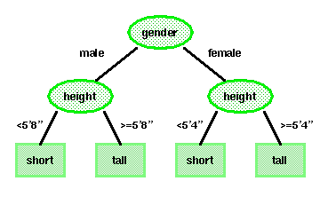
Decision Trees
A decision tree is an approach to predictive analysis that can help you make decisions.
A decision tree consists of nodes and leaves, with each leaf denoting a class.
Classes (tall or short) are the outputs of the tree.
Attributes (gender and height) are a set of features that describe the data.
The input data consists of values of the different attributes. Using these attribute values, the decision tree generates a class as the output for each input data.

Slide 5
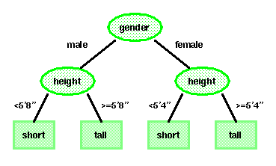
Basic Principles
The top, or first node, is called the root node.
The last level of nodes are the leaf nodes and contain the final classification.
The intermediate nodes are the descendant or “hidden” layers.
Binary trees, like the one shown to the right, are the most popular type of tree. However, M-ary trees (M branches at each node) are possible.
Decision trees attempt to classify a pattern through a sequence of questions. For example, attributes such as gender and height can be used to classify people as short or tall. But the best threshold for height is gender dependent. In a binary tree, by convention if the answer to a question is “yes”, the left branch is selected.
Key questions include how to grow the tree, how to stop growing, and how to prune the tree to increase generalization.

Slide 6
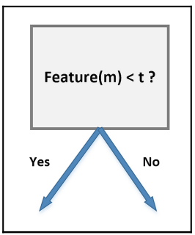
Binary decisions
A binary decision tree is a structure based on a sequential decision process. Starting from the root, a feature is evaluated and one of the two branches is selected. This procedure is repeated until a final leaf is reached, which normally represents the classification target.
Let's consider an input dataset X
In the dataset, we have n data points, and each point has m features. Then the decision tree might look like this where t is the threshold value
According to the feature and the threshold, the structure of the tree will change.
Pick the feature that best separates our data
A perfect separating feature will be present in a node so that node will be able to separate the data in the best way. If we choose such a node, it reduces the number of steps, and we get the target in less number of steps and complexity.

Slide 7
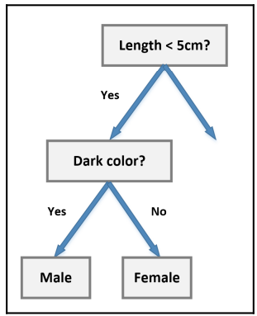
Binary decisions
It's necessary to find the feature that minimizes the number of following decision steps.
For example, let's consider a class of students where all males have dark hair and all females have blonde hair, while both subsets have samples of different sizes. If our task is to determine the composition of the class, we can start with the following subdivision:

Slide 8
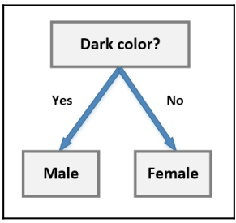
Binary decisions
However, the block Dark color will contain both males and females (which are the targets we want to classify). This concept is expressed using the term purity. An ideal scenario is based on nodes where the impurity is null so that all subsequent decisions will be taken only on the remaining features.
In our example, we can simply start from the color block:
Since we do not need the separation based on the length of the hair, so it is called impurity. Impurity nodes are added to the tree, which unnecessarily makes the structure bigger and more complex.

Slide 9
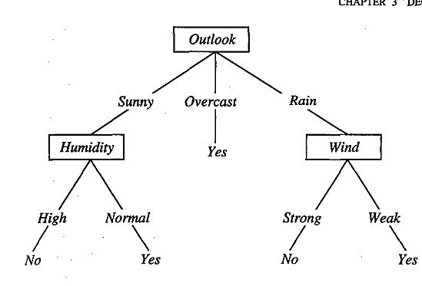
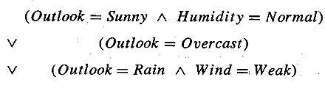
DECISION TREE REPRESENTATION
A decision tree can contain categorical data (YES/NO) as well as numeric data.
Figure illustrates a typical learned decision tree. This decision tree classifies Saturday mornings according to whether they are suitable for playing tennis.
For example, the instance (Outlook = Sunny, Temperature = Hot, Humidity = High, Wind = Strong) would be sorted down the leftmost branch of this decision tree and would therefore be classified as a negative instance (i.e., the tree predicts that PlayTennis = no).
The decision tree shown in Figure corresponds to the expression

Slide 10
How do Decision Trees work?
The decision of making strategic splits heavily affects a tree’s accuracy. The decision criteria are different for classification and regression trees.
Decision trees use multiple algorithms to decide to split a node into two or more sub-nodes. The creation of sub-nodes increases the homogeneity of resultant sub-nodes. In other words, we can say that the purity of the node increases with respect to the target variable. The decision tree splits the nodes on all available variables and then selects the split which results in most homogeneous sub-nodes.
The algorithm selection is also based on the type of target variables. Let us look at some algorithms used in Decision Trees:
ID3 → (extension of D3) C4.5 → (successor of ID3) CART → (Classification And Regression Tree) CHAID → (Chi-square automatic interaction detection Performs multi-level splits when computing classification trees) MARS → (multivariate adaptive regression splines)

Slide 11
How do Decision Trees work?
The ID3 algorithm builds decision trees using a top-down greedy search approach through the space of possible branches with no backtracking. A greedy algorithm, as the name suggests, always makes the choice that seems to be the best at that moment.
Steps in ID3 algorithm:
It begins with the original set S as the root node.
On each iteration of the algorithm, it iterates through the very unused attribute of the set S and calculates Entropy(H) and Information gain(IG) of this attribute.
It then selects the attribute which has the smallest Entropy or Largest Information gain.
The set S is then split by the selected attribute to produce a subset of the data.
The algorithm continues to recur on each subset, considering only attributes never selected before.

Slide 12
Attribute Selection Measures
If the dataset consists of N attributes then deciding which attribute to place at the root or at different levels of the tree as internal nodes is a complicated step. By just randomly selecting any node to be the root can’t solve the issue. If we follow a random approach, it may give us bad results with low accuracy.
For solving this attribute selection problem, researchers worked and devised some solutions. They suggested using some criteria like :
Entropy,
Information gain,
Gini index,
Gain Ratio,
Reduction in Variance
Chi-Square
These criteria will calculate values for every attribute. The values are sorted, and attributes are placed in the tree by following the order
Attribute with a high value(in case of information gain) is placed at the root.
While using Information Gain as a criterion, we assume attributes to be categorical, and
For the Gini index, attributes are assumed to be continuous.

Slide 13
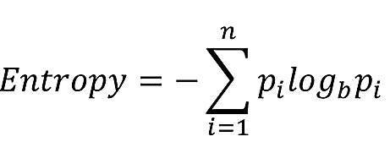
Entropy
Measures the level of impurity in a group of examples. Impurity is the degree of randomness; it tells how random our data is. if the target attribute can take on n different values, then the entropy of S relative to this n-wise classification is defined as:
Where p_{i} is the proportion of S belonging to class i. Note the logarithm is still base 2 because entropy is a measure of the expected encoding length measured in bits.
Now we can rewrite:
Entropy= -(p₁*log₂(p₁) + p₂*log₂(p₂) + .. + p_{n}*log₂(p_{n}))

Slide 14
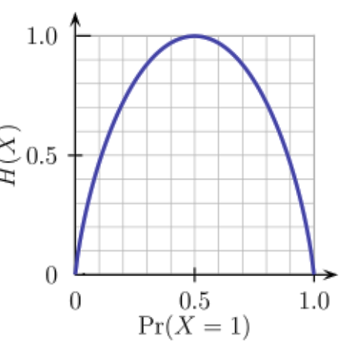
Entropy
Entropy is a measure of the randomness in the information being processed. The higher the entropy, the harder it is to draw any conclusions from that information. Flipping a coin is an example of an action that provides information that is random.
From the above graph, it is quite evident that the entropy H(X) is zero when the probability is either 0 or 1. The Entropy is maximum when the probability is 0.5 because it projects perfect randomness in the data and there is no chance if perfectly determining the outcome.

Slide 15
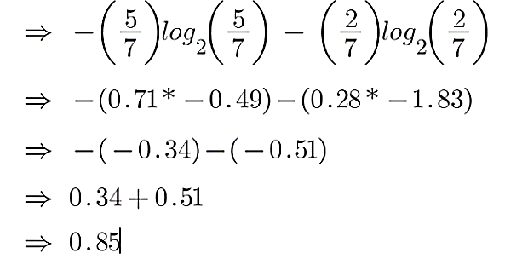
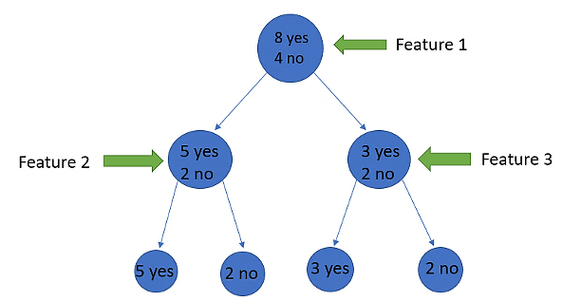
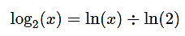
Entropy-Example 01
A pure sub-split means that either you should be getting “yes”, or you should be getting “no”.
Suppose a feature as 8 “yes” and 4 “no” initially, after the first split the left node gets 5 ‘yes’ and 2 ‘no’ whereas right node gets 3 ‘yes’ and 2 ‘no’.
We see here the split is not pure, why? Because we can still see some negative classes in both the nodes. In order to make a decision tree, we need to calculate the impurity of each split, and when the purity is 100%, we make it as a leaf node.
To check the impurity of feature 2 and feature 3 we will take the help for Entropy formula.
For feature 2,

Slide 16
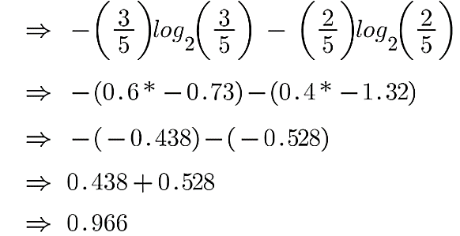
Entropy-Example 01
For feature 3,
We can clearly see from the tree itself that left node has low entropy or more purity than right node since left node has a greater number of “yes” and it is easy to decide here.

Slide 17
Information gain
Information gain or IG is a statistical property that measures how well a given attribute separates the training examples according to their target classification.
Constructing a decision tree is all about finding an attribute that returns the highest information gain and the smallest entropy.
Information gain measures the reduction of uncertainty given some feature and it is also a deciding factor for which attribute should be selected as a decision node or root node.
Information gain is used in both classification and regression decision trees. In classification, entropy is used as a measure of impurity, while in regression, variance is used as a measure of impurity

Slide 18
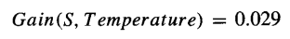
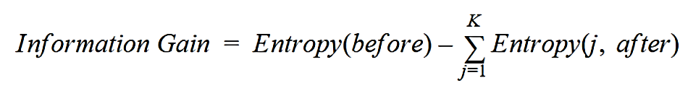
Information gain
Information gain is a decrease in entropy. It computes the difference between entropy before split and average entropy after split of the dataset based on given attribute values. ID3 (Iterative Dichotomiser) decision tree algorithm uses information gain.
In a much simpler way, we can conclude that:
Where “before” is the dataset before the split, K is the number of subsets generated by the split, and (j, after) is subset j after the split.

Slide 19
Information gain
It is just entropy of the full dataset – entropy of the dataset given some feature.
To understand this better let’s consider an example:
Suppose our entire population has a total of 30 instances. The dataset is to predict whether the person will go to the gym or not. Let’s say 16 people go to the gym and 14 people don’t
Now we have two features to predict whether he/she will go to the gym or not.
Feature 1 is “Energy” which takes two values “high” and “low”
Feature 2 is “Motivation” which takes 3 values “No motivation”, “Neutral” and “Highly motivated”.

Slide 20
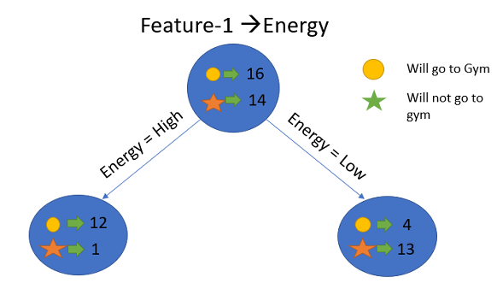
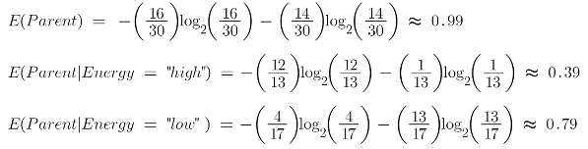
Information gain-Example 01
Let’s see how our decision tree will be made using these 2 features. We’ll use information gain to decide which feature should be the root node and which feature should be placed after the split.
Let’s calculate the entropy

Slide 21
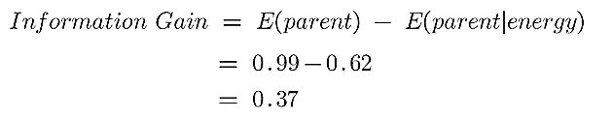
Information gain-Example 01
To see the weighted average of entropy of each node we will do as follows:
Now we have the value of E(Parent) and E(Parent|Energy), information gain will be:
Our parent entropy was near 0.99 and after looking at this value of information gain, we can say that the entropy of the dataset will decrease by 0.37 if we make “Energy” as our root node.
Similarly, we will do this with the other feature “Motivation” and calculate its information gain.

Slide 22
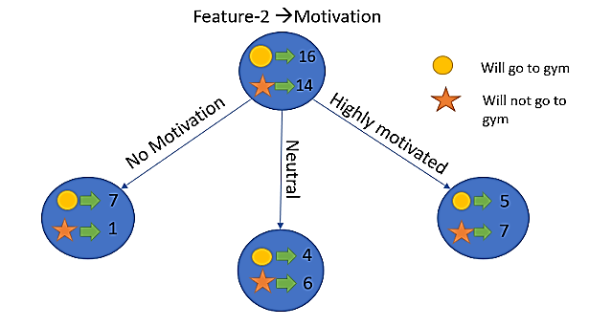
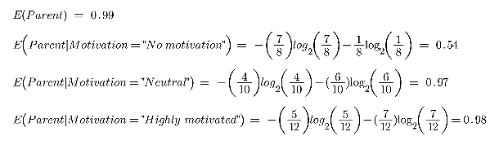
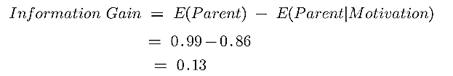
Information gain-Example 01
Let’s calculate the entropy here:
To see the weighted average of entropy of each node we will do as follows:
Now we have the value of E(Parent) and E(Parent|Motivation), information gain will be:

Slide 23
Information gain-Example 01
We now see that the “Energy” feature gives more reduction which is 0.37 than the “Motivation” feature. Hence we will select the feature which has the highest information gain and then split the node based on that feature.
In this example “Energy” will be our root node and we’ll do the same for sub-nodes. Here we can see that when the energy is “high” the entropy is low and hence we can say a person will definitely go to the gym if he has high energy, but what if the energy is low? We will again split the node based on the new feature which is “Motivation”.

Slide 24
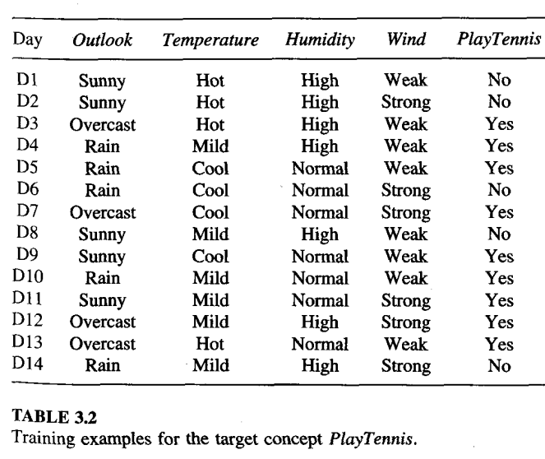
Entropy-Example 02
Golf
Golf

Slide 25
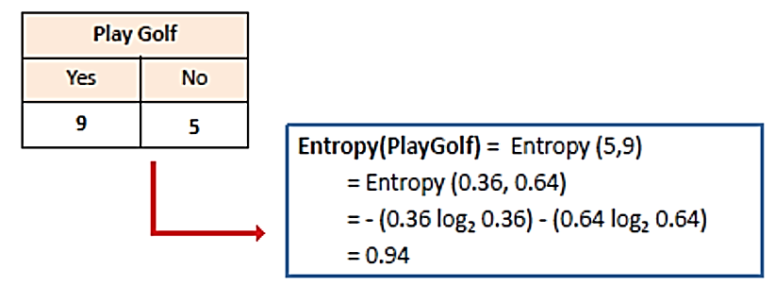
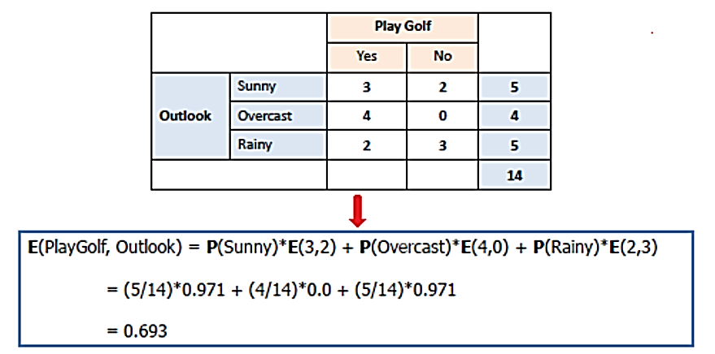
Entropy-Example 02
Entropy for multiple attributes is represented as:

Slide 26
Entropy
Always remember that the higher the Entropy, the lower will be the purity and the higher will be the impurity.
As the goal of machine learning is to decrease the uncertainty or impurity in the dataset, here by using the entropy we are getting the impurity of a particular node, we don’t know if the parent entropy or the entropy of a particular node has decreased or not.
For this, we bring a new metric called “Information gain” which tells us how much the parent entropy has decreased after splitting it with some feature.

Slide 27
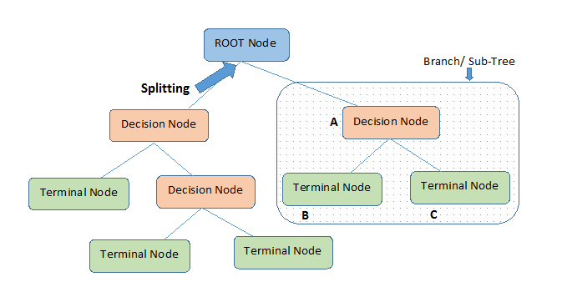
Important Terminology
Root Node: It represents the entire population or sample and this further gets divided into two or more homogeneous sets.
Splitting: It is a process of dividing a node into two or more sub-nodes.
Decision Node: When a sub-node splits into further sub-nodes, then it is called the decision node.
Leaf / Terminal Node: Nodes do not split is called Leaf or Terminal node.
Pruning: When we remove sub-nodes of a decision node, this process is called pruning. You can say the opposite process of splitting.
Branch / Sub-Tree: A subsection of the entire tree is called branch or sub-tree.

Slide 28
Decision Tree Algorithm
The decision tree algorithm can be used for solving regression and classification problems
The goal of using a Decision Tree is to create a training model that can use to predict the class or value of the target variable by learning simple decision rules inferred from training data.
In Decision Trees, for predicting a class label for a record we start from the root of the tree. We compare the values of the root attribute with the record’s attribute. On the basis of comparison, we follow the branch corresponding to that value and jump to the next node.

Slide 29
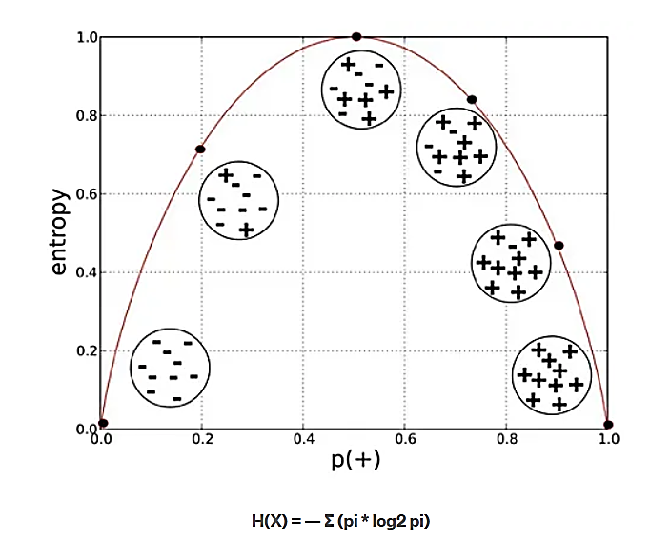
Decision Tree Algorithm
ID3 algorithm uses entropy to calculate the homogeneity of a sample. If the sample is completely homogeneous the entropy is zero and if the sample is an equally divided it has entropy of one.

Slide 30
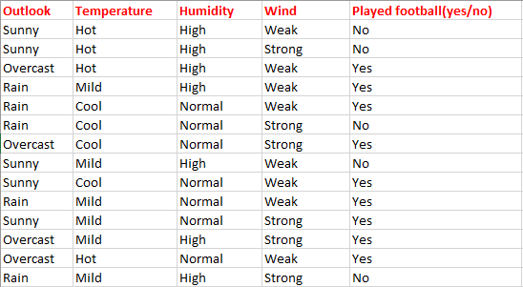
Classification using the ID3 algorithm
Consider a dataset based on which we will determine whether to play football or not.
Here There are four independent variables to determine the dependent variable.
The independent variables are Outlook, Temperature, Humidity, and Wind.
The dependent variable is whether to play football or not.

Slide 31
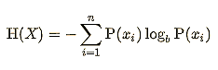
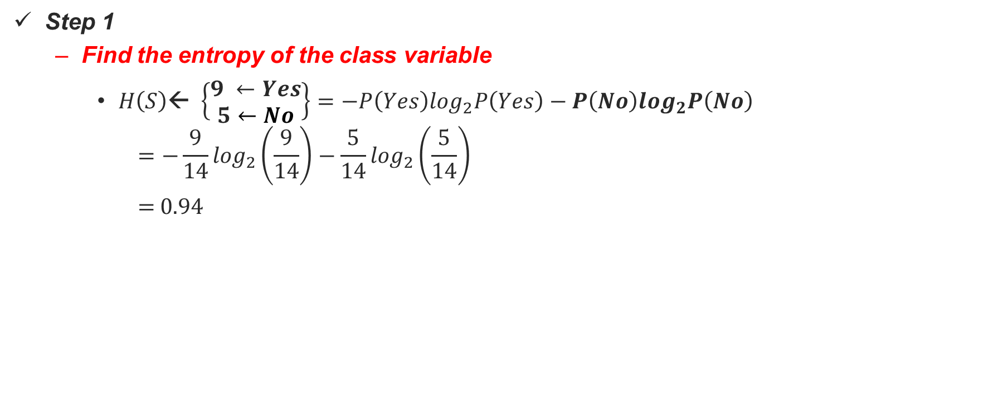
Calculations
Here
9 samples are Yes
5 samples are No
Step 1
Find the entropy of the class variable
$H\left(S\right)\text{← }\left\{\begin{aligned}9 ←Yes \\ 5←No\end{aligned}\right\}=−P\left(Yes\right)\log_{2}P\left(Yes\right)−P\left(No\right)\log_{2}P\left(No\right)$
$$=−\frac{9}{14}\log_{2}\left(\frac{9}{14}\right)−\frac{5}{14}\log_{2}\left(\frac{5}{14}\right)$$
= 0.94

Slide 32
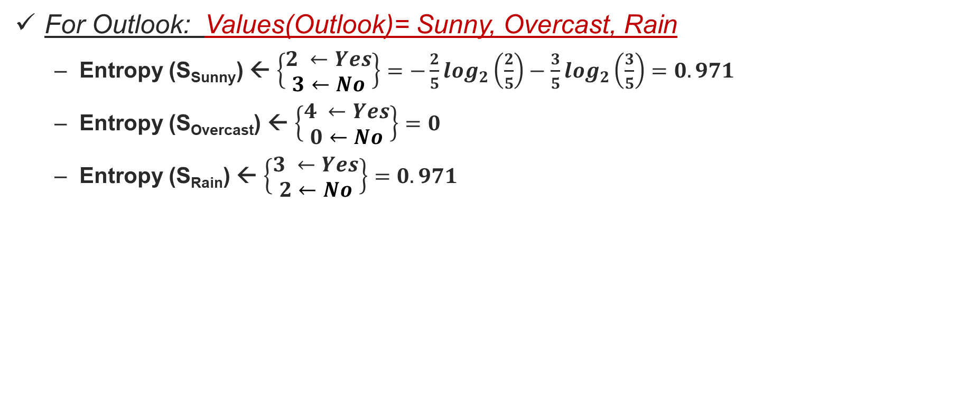
Step 2: Calculate average weighted entropy for each attribute
For Outlook: Values(Outlook)= Sunny, Overcast, Rain
Entropy (S_{Sunny}) ← $\left\{\begin{aligned}2 ←Yes \\ 3←No\end{aligned}\right\}=−\frac{2}{5}\log_{2}\left(\frac{2}{5}\right)−\frac{3}{5}\log_{2}\left(\frac{3}{5}\right)=0.971$
Entropy (S_{Overcast}) ← $\left\{\begin{aligned}4 ←Yes \\ 0←No\end{aligned}\right\}=0$
Entropy (S_{Rain}) ← $\left\{\begin{aligned}3 ←Yes \\ 2←No\end{aligned}\right\}=0.971$

Slide 33
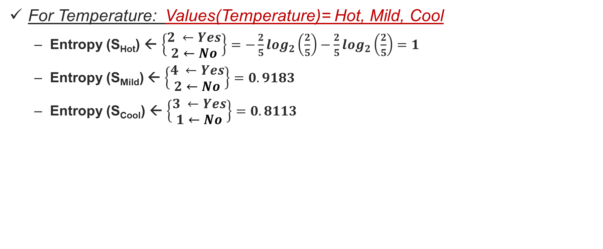
Step 2: Calculate average weighted entropy for each attribute (Cont…)
For Temperature: Values(Temperature)= Hot, Mild, Cool
Entropy (S_{Hot}) ← $\left\{\begin{aligned}2 ←Yes \\ 2←No\end{aligned}\right\}=−\frac{2}{5}\log_{2}\left(\frac{2}{5}\right)−\frac{2}{5}\log_{2}\left(\frac{2}{5}\right)=1$
Entropy (S_{Mild}) ← $\left\{\begin{aligned}4 ←Yes \\ 2←No\end{aligned}\right\}=0.9183$
Entropy (S_{Cool}) ← $\left\{\begin{aligned}3 ←Yes \\ 1←No\end{aligned}\right\}=0.8113$

Slide 34
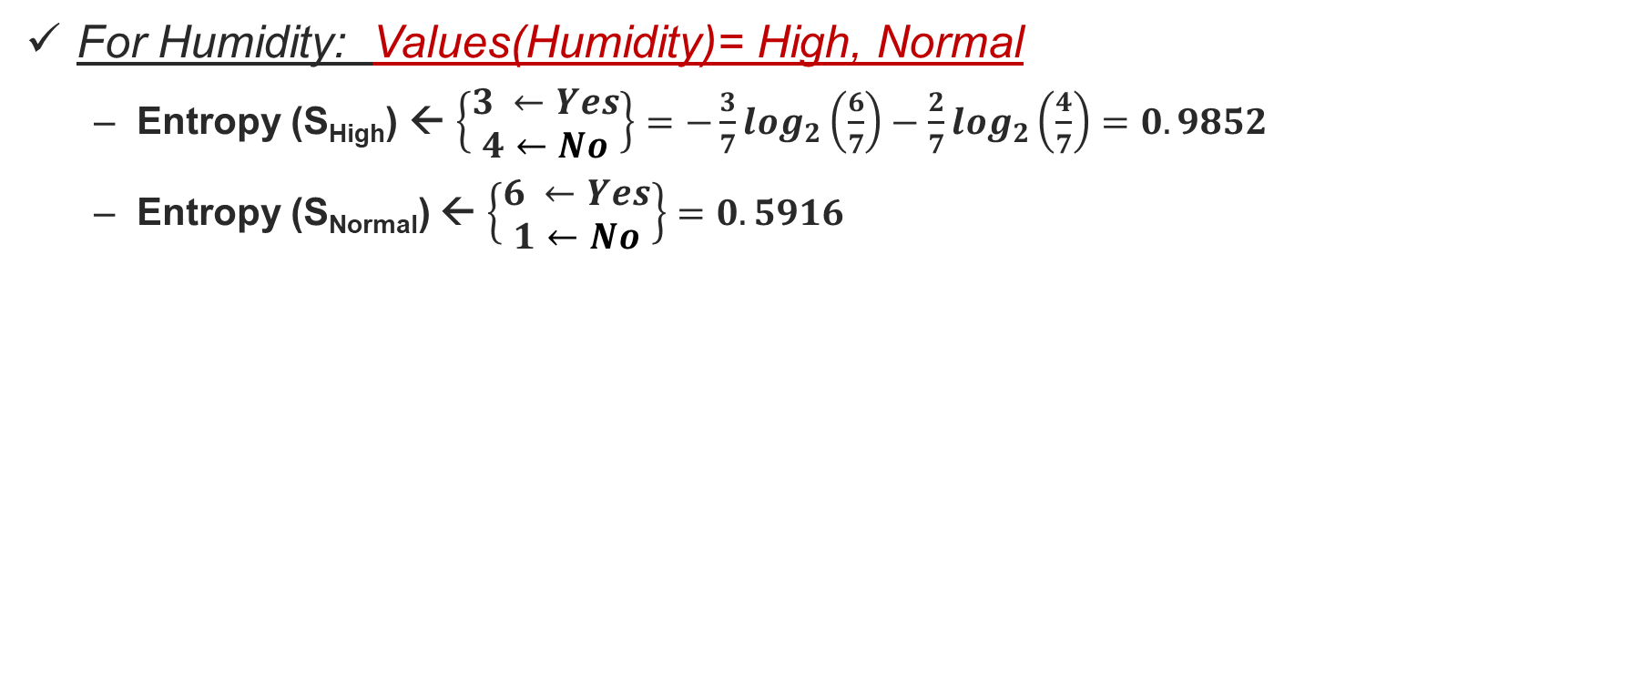
Step 2: Calculate average weighted entropy for each attribute (Cont…)
For Humidity: Values(Humidity)= High, Normal
Entropy (S_{High}) ← $\left\{\begin{aligned}3 ←Yes \\ 4←No\end{aligned}\right\}=−\frac{3}{7}\log_{2}\left(\frac{6}{7}\right)−\frac{2}{7}\log_{2}\left(\frac{4}{7}\right)=0.9852$
Entropy (S_{Normal}) ← $\left\{\begin{aligned}6 ←Yes \\ 1←No\end{aligned}\right\}=0.5916$

Slide 35
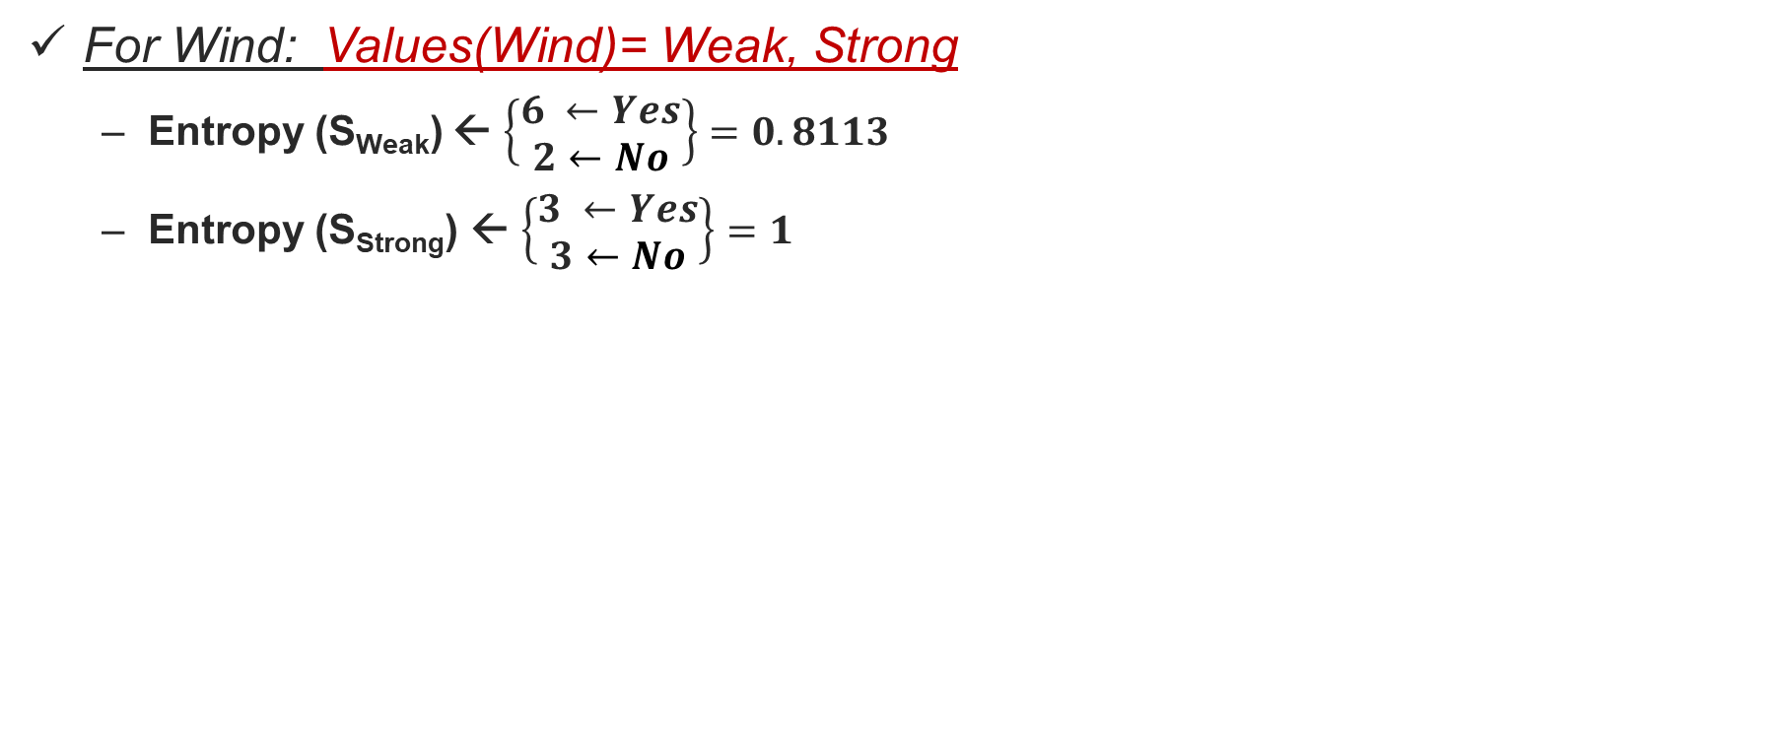
Step 2: Calculate average weighted entropy for each attribute (Cont…)
For Wind: Values(Wind)= Weak, Strong
Entropy (S_{Weak}) ← $\left\{\begin{aligned}6 ←Yes \\ 2←No\end{aligned}\right\}=0.8113$
Entropy (S_{Strong}) ← $\left\{\begin{aligned}3 ←Yes \\ 3←No\end{aligned}\right\}=1$

Slide 36
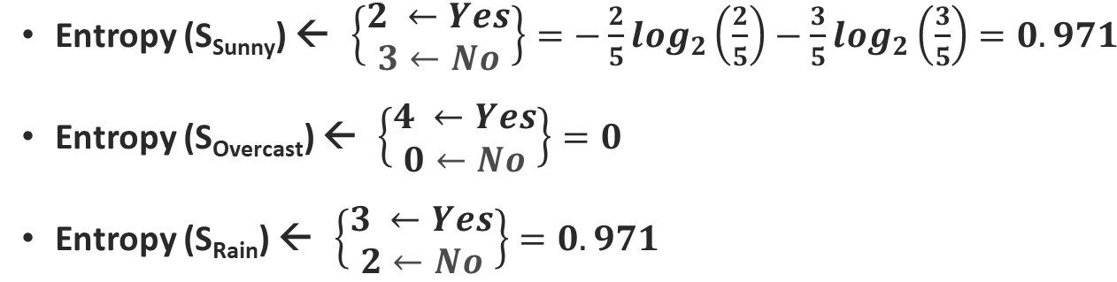
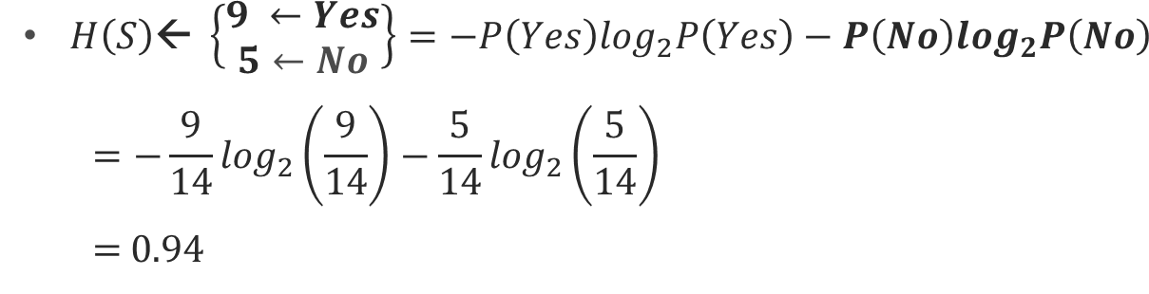
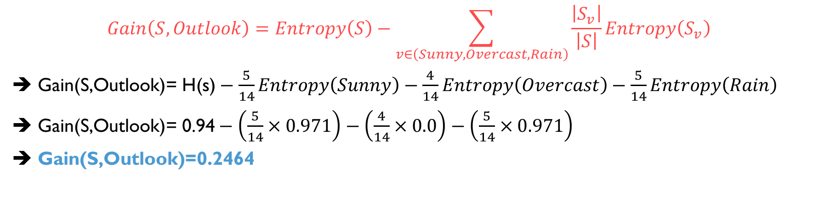
Step3: Find the information gain: Outlook
Information gain is the difference between parent entropy and average weighted entropy we found above.
$$Gain\left(S,Outlook\right)=Entropy\left(S\right)−\sum_{v∈\left(Sunny, Overcast, Rain\right)}{\frac{\left|S_{v}\right|}{\left|S\right|}Entropy\left(S_{v}\right)}$$
➔ $\text{G}\text{ain}\text{(}\text{S}\text{,}\text{Outlook}\text{)= }\text{H}\text{(}\text{s}\text{)}−\frac{5}{14}Entropy\left(Sunny\right)−\frac{4}{14}Entropy\left(Overcast\right)−\frac{5}{14}Entropy\left(Rain\right)$
➔ $\text{G}\text{ain}\text{(}\text{S}\text{,}\text{Outlook}\text{)= 0.94}−\left(\frac{5}{14}×0.971\right)−\left(\frac{4}{14}×0.0\right)−\left(\frac{5}{14}×0.971\right)$
➔ $\text{Gain}\text{(}\text{S}\text{,}\text{Outlook}\text{)=0.2464}$

Slide 37
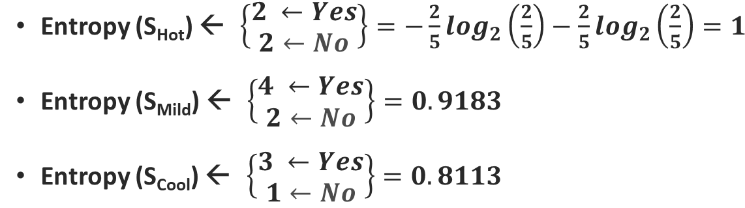
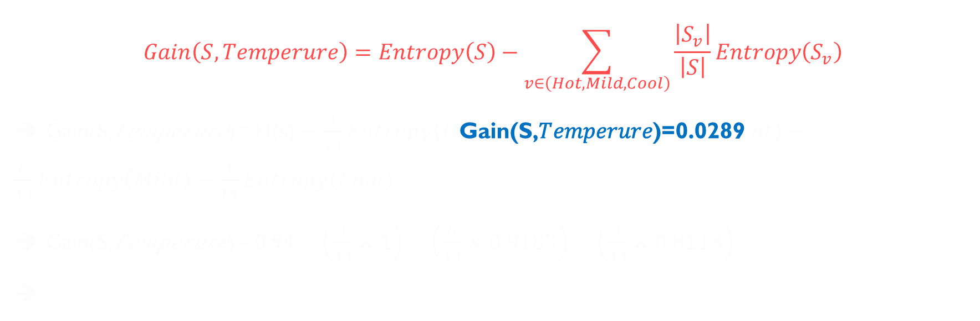
Gain: Temperature
$$Gain\left(S,Temperure\right)=Entropy\left(S\right)−\sum_{v∈\left(Hot, Mild, Cool\right)}{\frac{\left|S_{v}\right|}{\left|S\right|}Entropy\left(S_{v}\right)}$$
➔ $\text{G}\text{ain}\text{(}\text{S}\text{,}\text{Temperure}\text{)= }\text{H}\text{(}\text{s}\text{)}−\frac{4}{14}Entropy\left(H\text{Gain}\text{(}\text{S}\text{,}\text{Temperure}\text{)=0.0289 }ot\right)−\frac{6}{14}Entropy\left(Mild\right)−\frac{4}{14}Entropy\left(Cool\right)$
➔ $\text{Gain}\text{(}\text{S}\text{,}\text{Temperure}\text{)= 0.94}−\left(\frac{4}{14}×1\right)−\left(\frac{6}{14}×0.9183\right)−\left(\frac{4}{14}×0.8113\right)$
➔

Slide 38
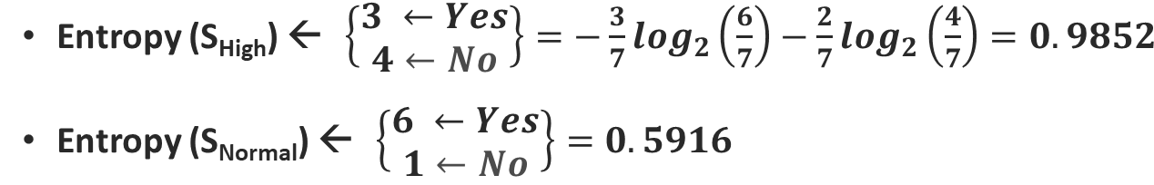
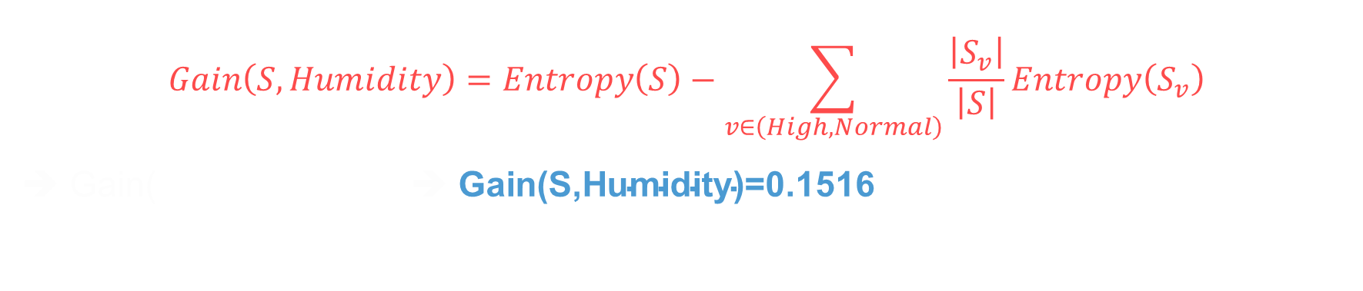
Gain: Humidity
$$Gain\left(S,Humidity\right)=Entropy\left(S\right)−\sum_{v∈\left(High, Normal\right)}{\frac{\left|S_{v}\right|}{\left|S\right|}Entropy\left(S_{v}\right)}$$
➔ $\text{G}\text{ain}\text{(}$ ➔ $\text{Gain}\text{(}\text{S}\text{,}\text{Humidity}\text{)=0.}\text{1516}$

Slide 39
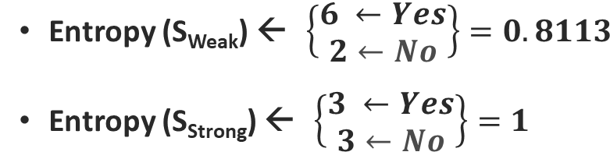
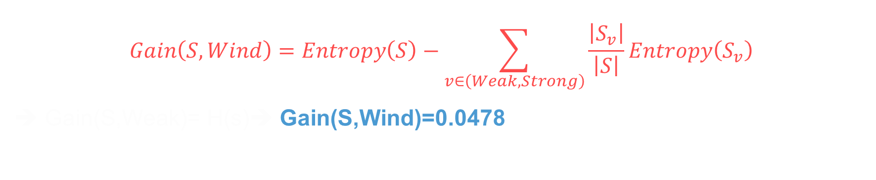
Gain: Wind
$$Gain\left(S,Wind\right)=Entropy\left(S\right)−\sum_{v∈\left(Weak, Strong\right)}{\frac{\left|S_{v}\right|}{\left|S\right|}Entropy\left(S_{v}\right)}$$
➔ $\text{G}\text{ain}\text{(}\text{S}\text{,}\text{Weak}\text{)= }\text{H}\text{(}\text{s}\text{)}$➔ $\text{Gain}\text{(}\text{S}\text{,}\text{Wind}\text{)=0.}\text{0478}$

Slide 40
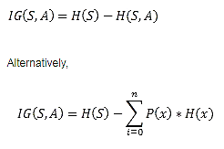
Information gain
IG(S, outlook) = 0.94 - 0.693 = 0.247
IG(S, Temperature) = 0.940 - 0.911 = 0.029
IG(S, Humidity) = 0.940 - 0.788 = 0.152
IG(S, Windy) = 0.940 - 0.8932 = 0.048

Slide 41
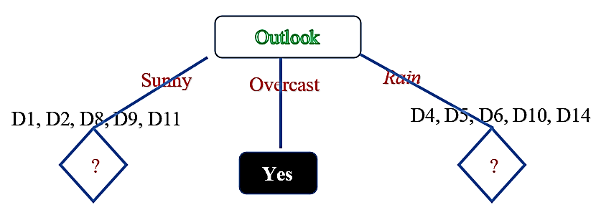
Finding Root Node
Since Outlook has the highest gain so, Outlook is the root node. And it has three child nodes (Sunny, Overcast, Rain)

Slide 42
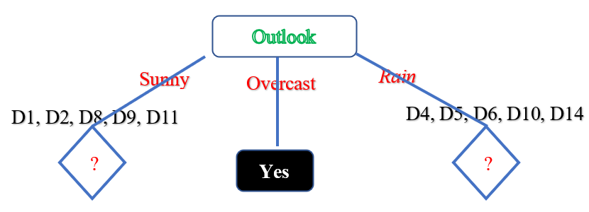
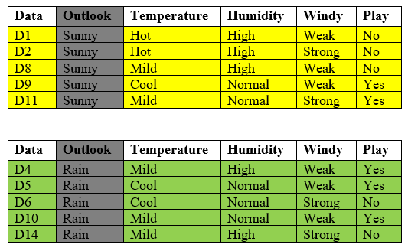
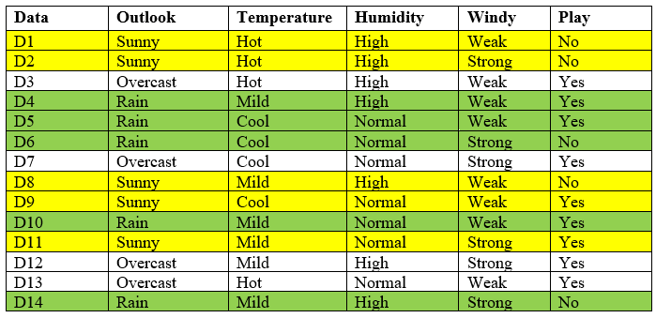

Slide 43
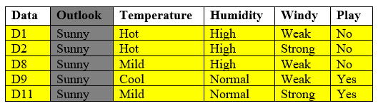
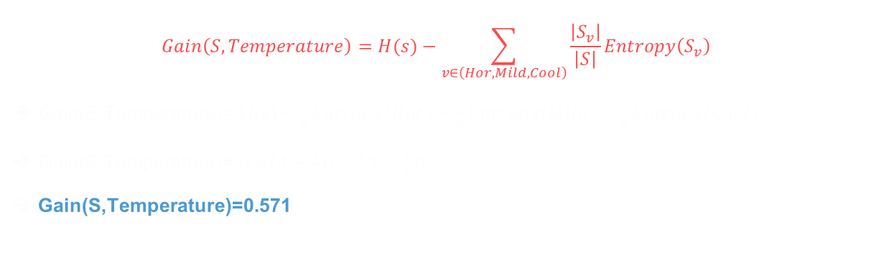
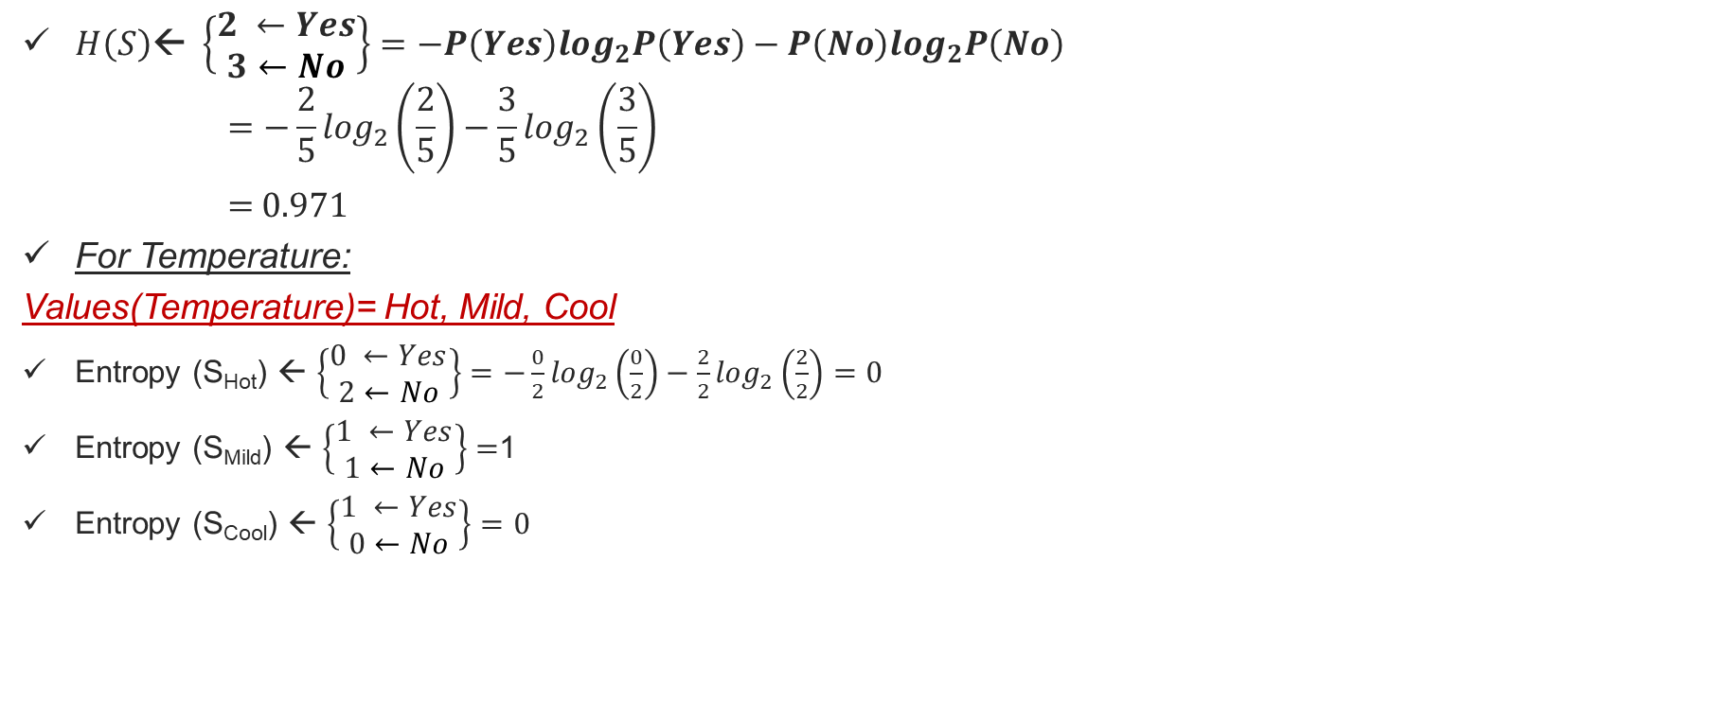
Calculate IG of Temperature
$H\left(S\right)\text{← }\left\{\begin{aligned}2 ←Yes \\ 3←No\end{aligned}\right\}=−P\left(Yes\right)\log_{2}P\left(Yes\right)−P\left(No\right)\log_{2}P\left(No\right)$
$$=−\frac{2}{5}\log_{2}\left(\frac{2}{5}\right)−\frac{3}{5}\log_{2}\left(\frac{3}{5}\right)$$
= 0.971
For Temperature:
Values(Temperature)= Hot, Mild, Cool
Entropy (S_{Hot}) ← $\left\{\begin{aligned}0 ←Yes \\ 2←No\end{aligned}\right\}=−\frac{0}{2}\log_{2}\left(\frac{0}{2}\right)−\frac{2}{2}\log_{2}\left(\frac{2}{2}\right)=0$
Entropy (S_{Mild}) ← $\left\{\begin{aligned}1 ←Yes \\ 1←No\end{aligned}\right\}=$1
Entropy (S_{Cool}) ← $\left\{\begin{aligned}1 ←Yes \\ 0←No\end{aligned}\right\}=0$
$$Gain\left(S,Temperature\right)=H(s)−\sum_{v∈\left(Hor, Mild, Cool\right)}{\frac{\left|S_{v}\right|}{\left|S\right|}Entropy\left(S_{v}\right)}$$
➔ $\text{G}\text{ain}\text{(}\text{S}\text{,}\text{Temperature}\text{)= }\text{H}\text{(}\text{s}\text{)}−\frac{2}{5}Entropy\left(Hot\right)−\frac{2}{5}Entropy\left(Mild\right)−\frac{1}{5}Entropy\left(Cool\right)$
➔ $\text{Gain}\text{(}\text{S}\text{,}\text{Temperature}\text{)= 0.}\text{971}−\frac{2}{5}0−\frac{2}{5}1−\frac{1}{5}0$
➔ $\text{Gain}\text{(}\text{S}\text{,}\text{Temperature}\text{)=0.}\text{571}$

Slide 44


Calculate IG of Humidity
$H\left(S\right)\text{← }\left\{\begin{aligned}2 ←Yes \\ 3←No\end{aligned}\right\}=−P\left(Yes\right)\log_{2}P\left(Yes\right)−P\left(No\right)\log_{2}P\left(No\right)$
$$=−\frac{2}{5}\log_{2}\left(\frac{2}{5}\right)−\frac{3}{5}\log_{2}\left(\frac{3}{5}\right)$$
= 0.971
For Humidity:
Values(Humidity)= High, Normal
Entropy (S_{High}) ← $\left\{\begin{aligned}0 ←Yes \\ 3←No\end{aligned}\right\}=−\frac{0}{3}\log_{2}\left(\frac{0}{3}\right)−\frac{3}{3}\log_{2}\left(\frac{3}{3}\right)=0$
Entropy (S_{Normal}) ← $\left\{\begin{aligned}2 ←Yes \\ 0←No\end{aligned}\right\}=0$
$$Gain\left(S,Humidity\right)=H(s)−\sum_{v∈\left(High Normal\right)}{\frac{\left|S_{v}\right|}{\left|S\right|}Entropy\left(S_{v}\right)}$$
➔ $\text{G}\text{ain}\text{(}\text{S}\text{,}\text{Humidity}\text{)= }\text{H}\text{(}\text{s}\text{)}−\frac{3}{5}Entropy\left(High\right)−\frac{2}{5}Entropy\left(Normal\right)$
$\text{Gain}\text{(}\text{S}\text{,}\text{Temperature}\text{)= 0.}\text{971}−0$
$\text{Gain}\text{(}\text{S}\text{,}\text{Humidity}\text{)=0.}\text{971}$

Slide 45


Calculate IG of Windy
$H\left(S\right)\text{← }\left\{\begin{aligned}2 ←Yes \\ 3←No\end{aligned}\right\}=−P\left(Yes\right)\log_{2}P\left(Yes\right)−P\left(No\right)\log_{2}P\left(No\right)$
$$=−\frac{2}{5}\log_{2}\left(\frac{2}{5}\right)−\frac{3}{5}\log_{2}\left(\frac{3}{5}\right)$$
= 0.971
For Windy:
Values(Windy)= Weak, Strong
Entropy (S_{Weak}) ← $\left\{\begin{aligned}1 ←Yes \\ 2←No\end{aligned}\right\}=−\frac{1}{3}\log_{2}\left(\frac{1}{3}\right)−\frac{2}{3}\log_{2}\left(\frac{2}{3}\right)=.5278$
Entropy (S_{Strong} ← $\left\{\begin{aligned}1 ←Yes \\ 1←No\end{aligned}\right\}=1$
$$Gain\left(S,Humidity\right)=H(s)−\sum_{v∈\left(High Normal\right)}{\frac{\left|S_{v}\right|}{\left|S\right|}Entropy\left(S_{v}\right)}$$
➔ $\text{G}\text{ain}\text{(}\text{S}\text{,}\text{Humidity}\text{)= }\text{H}\text{(}\text{s}\text{)}−\frac{3}{5}Entropy\left(High\right)−\frac{2}{5}Entropy\left(Normal\right)$
$\text{Gain}\text{(}\text{S}\text{,}\text{Temperature}\text{)= 0.}\text{971}−0$
$\text{Gain}\text{(}\text{S}\text{,}\text{Windy}\text{)=0.}\text{019}$

Slide 46




Information gain
➔ $\text{Gain}\text{(}\text{S}\text{,}\text{Temperature}\text{)=0.571}$
$$\text{Gain}\text{(}\text{S}\text{,}\text{Humidity}\text{)=0.971}$$
$\text{Gain}\text{(}\text{S}\text{,}\text{Windy}\text{)=0.019}$

Slide 47


Calculate IG of Temperature

Slide 48

Calculate IG of Humidity

Slide 49

Calculate IG of Windy

Slide 50

Information gain

Slide 51

A decision tree for the concept PlayTennis
An example is classified by sorting it through the tree to the appropriate leaf node, then returning the classification associated with this leaf (in this case, Yes or No).
This tree classifies Saturday mornings according to whether or not they are suitable for playing tennis.

Slide 52
Thank You

